Slide 1
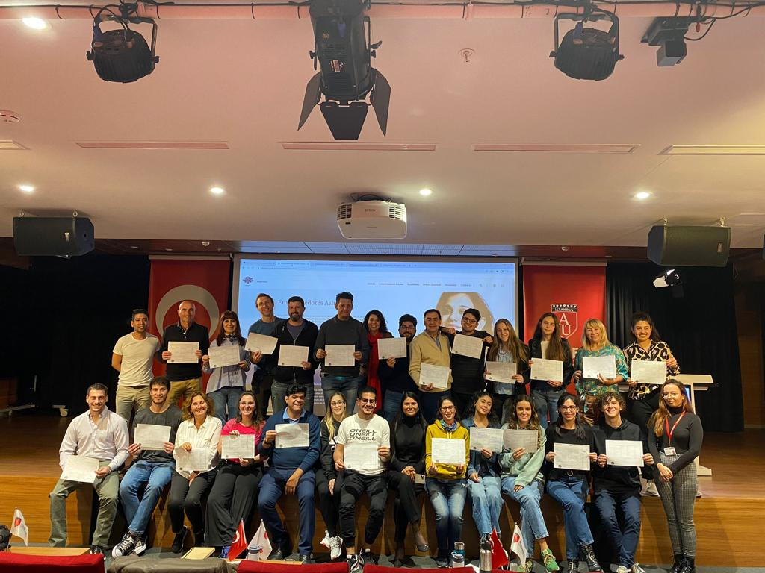
The next era of Business
Thrives on learning

Slide 2
www.gloaims.com
ABOUT US
GloAims Consultancy and Training offer engaging on-demand, simulation, and cohort-based learning that helps companies achieve critical business objectives, growth, and competitiveness. We equip companies with the tools to build an innovative and future-ready workforce, engaged employees, and favourable business outcomes. Our integrated learning and strategic partnership allow tailor-made training to customers’ needs; it will deliver the right learning experience to the right people in a suitable format.
WE OFFER
Training and development to overcome performance gaps and boost the productivity of your employees. On-demand, immersive, and cohort-based learning for your employees
Personalised training and actionable learner insights to drive high usage and measurable impact.

Slide 3
www.gloaims.com
OUR VISION & MISSION
We meet all your learning needs, so you don't have to spend time managing multiple providers
Leaders & Managers
Empower your leaders and managers to learn together,so they can impact cultural change at your company and drive business results
Company Vision
Human Resources
Prepare your HR team to attract, grow, and retain talent by equipping them with the tools and skills they need todo their best work.
Our talented team of international instructors has exceptional credentials that are complemented by practical, real-world experience. By bringing together academic knowledge and industry experience, we ensure that our clients’ needs are at the forefront of each and every one of our training courses and training courses
Learning & Development
Deliver L&D programs that upskill your entire workforce with courses taught by instructors from across the globe in a variety of dynamic formats.

Slide 4
www.gloaims.com
WHAT WE DO
Need-based Training
Enterprise-wide Training
We empower everyone to level up with learning, motivate, and support employees with training and guidance. We facilitate building a culture of learning at your organisation with on-demand training. We’ll work with your organisation to develop
and implement plans to build the skills of your employees.
Small Team Training
We find and bridge skill gaps to transform your teams of 5-20 employees.
Leadership Development
We help your people and business thrive with cohort learning for current and future leaders. Our unique training simulations improve leadership awareness and
Management Skills.
We offer to curate learning paths with personalised training to support extraordinary personal growth and leadership goals.

Slide 5
www.gloaims.com
HOW WE DO IT
On-demand training
It helps your organisation to close the skills gaps and increase productivity. Learning Paths for a personalised experience with customised content Develop talent within Your organisation and improve retention. Significantly reduce the training and Overhead costs Creativity and innovation increase business revenues Native-Language learning with five languages: English, Arabic, Turkish, Urdu, and Hindi
.
Expert Instructors
Our real-world instructors empower your teams to drive impactful learning.Our Instructor community includes professors, leaders, executive coaches, and Practitioners.We maintain fresh content and identify areas of improvement to ensure Quality. We offer Native-language learning in five languages: English Arabic, Turkish Urdu, and Hindi.
Global Content
Our instructors offer training on in-demand topics in their native language We tailor content to cultural nuances depending on the industry and region. We deliver training relevant to every culture.

Slide 6
TRAINING PROGRAMS
www.gloaims.com
Management
Executive Development
Leadership Agility
Executive Management & Leadership Development
Advanced Strategy for Executives
Strategy, Leadership, & Critical Thinking
Value Creation
Sustainable Business Strategy
Leadership
Management
Analysis of Management Decisions
Strategic Corporate Governance
Enterprise Leadership for Transformation

Slide 7
www.gloaims.com
Management and Leadership
Next Generation Leadership
Emotional Intelligence
Time Management and Stress Reduction
Communication for Leadership
Leadership Development
Innovation and Change Management
Team Management for Innovation and Success
Leadership Skills in Public Organisations
Leadership and Technology
Leadership and Strategy
Sustainable Leadership
Leading with Emotional Intelligence
Crisis Management and Leadership
Corporate Social Responsibility
Leading and Managing Change
Knowledge Management
Conflict Management Essential Skills for Oil and Gas Managers & Supervisors
Strategic, Operational, and Tactical Leadership in Oil and Gas Industry
Risk Management in Oil and Gas Industry
Next Generation Leadership
Emotional Intelligence
Time Management and Stress Reduction
Communication for Leadership
Leadership Development
Innovation and Change Management
Team Management for Innovation and Success
Leadership Skills in Public Organisations

Slide 8
www.gloaims.com
Engineering
Offshore & Marine Projects Risks Management
Crude Oil Tanker Cargo Operations
Loading Master for Oil, LNG
Cathodic Protection for Port Infrastructure
Oil and Gas Marine Terminals
Hydraulic Systems
Reducing Costs through Spares
Optimisation and Rationalisation
Root Cause Analysis (RCA)

Slide 9
www.gloaims.com
Personal Effectiveness
Building Personal Leadership Skills
Strategic Planning & Goal Setting
Priority Management
Personal Productivity and Positive Thinking
Strategic Communication
Communication for Leaders in the Digital Age
Change Management Through Effective Communication

Slide 10
www.gloaims.com
Corporate Governance, Compliance, & Risk Management
Risk Management and Compliance
Enterprise Risk Management
Operation Risk Management
Project Risk Management
Regulations and Control in Corporate Governance
Public Sector Management & Governance
Information and Documentation Compliance
Strategic Corporate Governance
Supply Chain Risk Management
Risk Management in Human Resources
Corporate Governance & Risk Management for State & Public Sector Organisations
Risk Management for Oil and Gas
Strategy Governance for Board

Slide 11
www.gloaims.com
Human Resource Management
Talent Management in the Oil and Gas Industry
Fundamentals of Human Resource Management
Culture and Change Management Innovation in Workforce Planning & Organisational Development
The Leadership of Inclusion
Workplace Ethics and ProductivityHR Development & Personal Management
Policy Initiatives and HR Transformation
Employee Relations and Engagement
Train the Trainer
Advanced Selection, Interviewing, & Recruitment Skills
Job Evaluation & Analysis
Managing Human Capital
Linking Training to Organisational Goals

Slide 12
www.gloaims.com
Project Management
Managing Project Control
Project Risk Management & Compliance
Project Scheduling & Cost Planning Skills
Managing Multiple Tasks, Priorities, & Deadlines
Project Appraisal
Project Coordination & Management
Agile Project Management
Essentials of Project Management Skills
Project Leadership Management and Communications
Essentials of Project Management Skills
Project Leadership Management and Communications
Project Risk Management and Compliance
Project Scheduling, Budgeting, and Cost Management

Slide 13
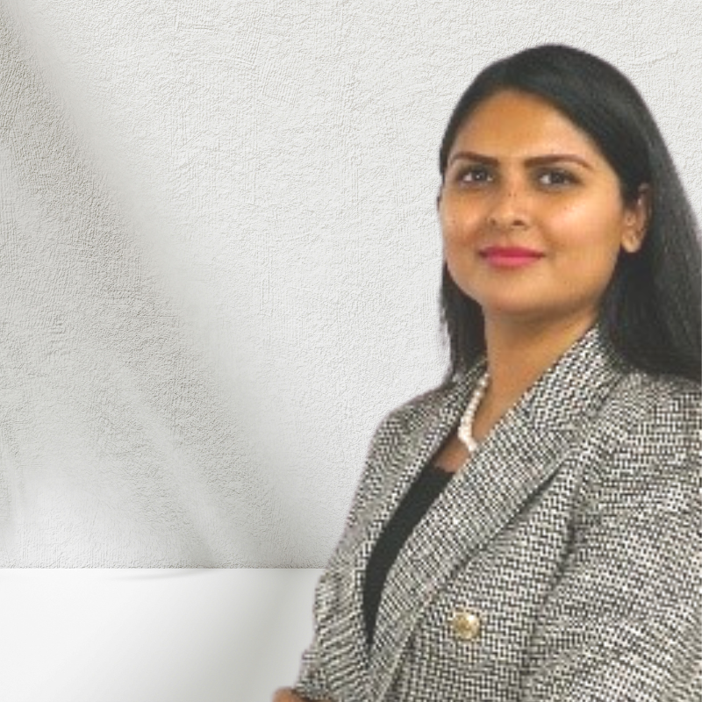
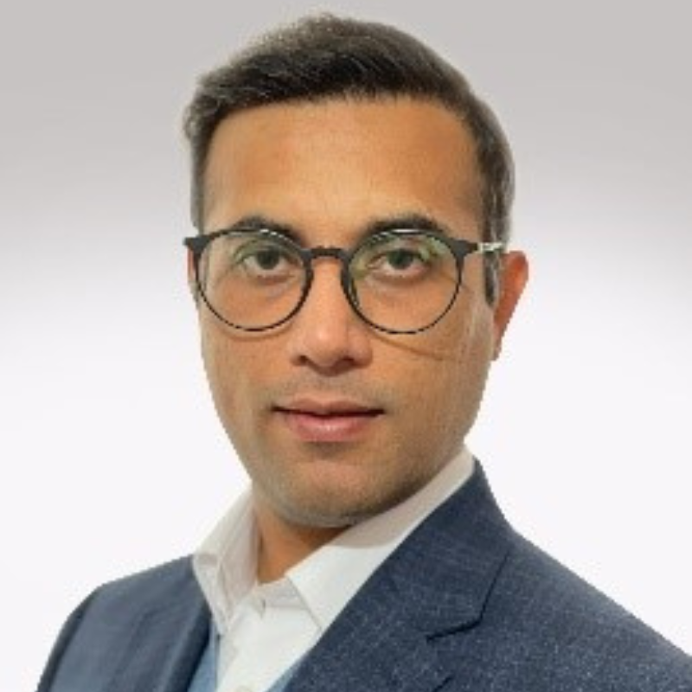
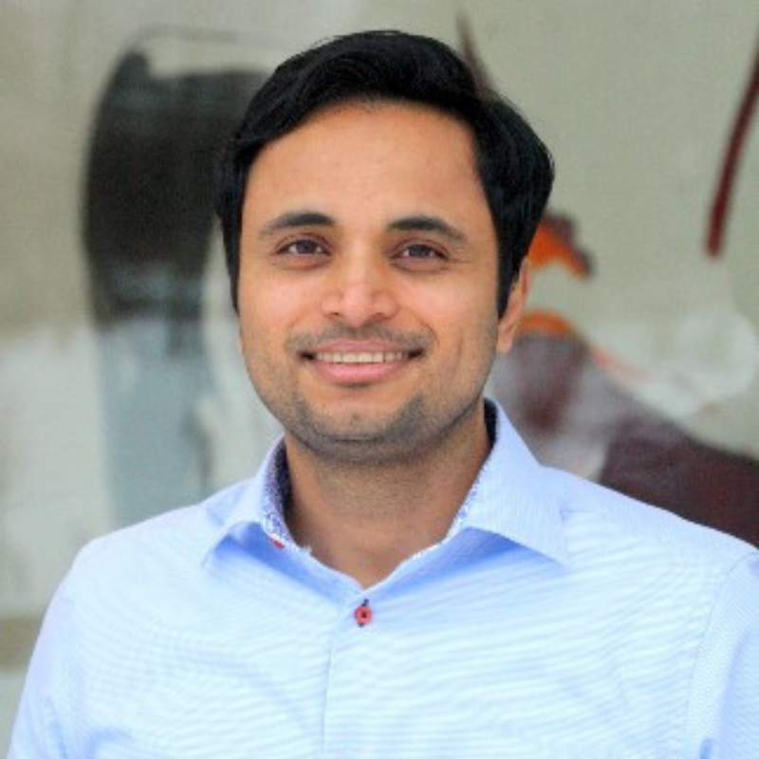
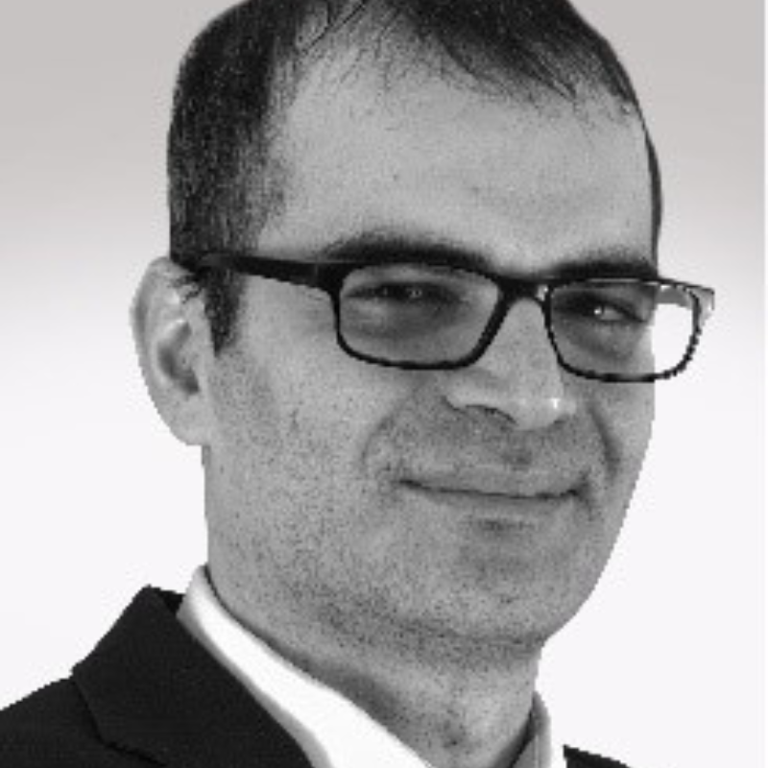
www.gloaims.com
REAL-WORD INSTRUCTORS
Dr. Bella Gulshan
Dr. Mohsen Liaqat
Dr. Tatbeeq Raza-Ullah
Dr. NABİ
KÜÇÜKGERGERLİ
CEO
Director of Programmes
Advisor Communication and Engagement
Assistant Professor of Business Administration at Altinbas University, Istanbul, Turkey. She is a certified trainer and expert in management and organisations. In 2022, she trained the leadership team of Dar Petroleum of South Sudan and the Ministry of Petroleum of South Sudan. She conducted a training program on process management for the National Oil Corporation of Libya in 2021.
Assistant Professor of Business Administration at Istanbul Health and Technology University, Turkey. Management consultant focusing on Intrapreneurship that integrates risk-taking and innovation approaches while working within a large organisation. Trainer on corporate social responsibility, corporate governance, and compliance.
Associate Professor of Strategy and Marketing at Nottingham Business School, England. Management and Strategy consultant in interfirm coopetition relationships enables firms to undertake highly complex, large-scale, risky, and innovative projects. Worked with the senior executive team of Strategic Sourcing and Partnering of Ericsson.
Assistant Professor of Business Administration at Istanbul Health and Technology University, Turkey. Certified public accountant with independent audit licenses. He has been serving as a consultant in several public companies for over 10 years.

Slide 14
THANK YOU!
info@gloaims.com
www.gloaims.com
Çalişlar Sk. No:17, Çobançeṣme, 34196 Bahçelievler, Istanbul, Turkey
www.gloaims.com

